Slide 1

A risk assessment and prediction framework for diabetes mellitus using Machine Learning Algorithms
Guided By
Dr. Saravanan N
Assistant Professor-III
School of Computing
SASTRA
G Dheeraj
Reg-125014011
ICT/SOC

Slide 2

Layout of this Presentation
Base Paper Details
Objective
Problem Statement
Literature Survey
Data Set
Methodologies proposed
Flow diagram
Outputs
Conclusion
References

Slide 3
BASE PAPER DETAILS:
Base paper URL : https://www.sciencedirect.com/science/article/pii/S2772442523001405
Title of the Base Paper : A risk assessment and prediction framework for diabetes mellitus using machine learning algorithms
Year of publication : 2023
ISSN NO : 27724425
Indexed in : SCOPUS

Slide 4
Objective
An approach to predict Diabetes Mellitus disease with higher accuracy
To select suitable prediction algorithms
To construct an ensemble which results in higher accuracy

Slide 5
PROBLEM STATEMENT
To develop a predictive model for early detection of diabetes mellitus using machine learning algorithms

Slide 6
LITERATURE SURVEY
S.No | Paper Title | Year of Publication | Authors | Methods used | Accuracy
1 | Analysis of Diabetes Mellitus for early prediction using optimal feature selection. | 2019 | N.Sneha, Tarun Gangil | Naive Bayes | 82%
2 | Machine learning based diabetes prediction and development of smart web application | 2021 | Nazin Ahmed, Rayhan Ahammed, Md.Manowarul, Arnisha Akhter | Decision Tree | 84%
3 | An investigation of machine learning algorithms and data augmentation techniques for diabetes diagnosis | 2024 | Mihrab Chowdhury, Ragib Shahariar Ayon Sakhawat Hossain | Gradient Boost | 83%

Slide 7
S.No | Paper Title | Year of Publication | Authors | Methods used | Accuracy
4 | Stacking ensemble approach to diagnosing the disease of diabetes | 2024 | Alfredo Daza, Juan Pinto, Carlos Fidel, Gonzalo Apaza-Perez | Logistic Regression | 91.5%
5 | Predicting the risk of diabetic retinopathy using explainable machine learning algorithms | 2023 | Merajul Islam, Jahanur Rahman Symun Rabby, Jahangir Alam | Extreme Gradient Boosting | 89.1%
6 | Detection of diabetic patients in people with normal fasting glucose using machine learning | 2023 | Lv Kun, Cui chunmei, Fan Rui | Logistic Regression | 84.2%

Slide 8
DATA SET
Diabetes Dataset https://www.kaggle.com/datasets/uciml/pima-indians-diabetes-database?resource=download

Slide 9
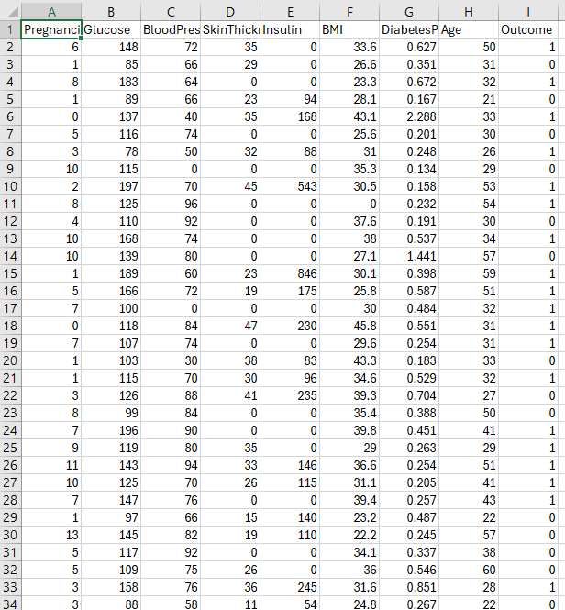

Slide 10
METHODOLOGIES PROPOSED
Logistic Regression
Gradient Boost
Decision Tree

Slide 11
FLOW DIAGRAM
Diabetes Dataset
Data Preprocessing
Filling missing values
Data Splitting
Training set
Applying model
Performance Evaluation
Testing set
K-fold cross validation
Compare Models
Choose best algorithm
Prediction of diabetes

Slide 12
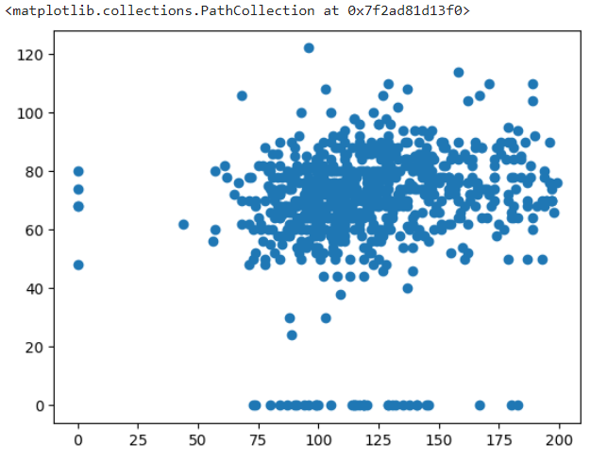
OUTPUTS
Scatter plot of Glucose and BloodPressure:

Slide 13
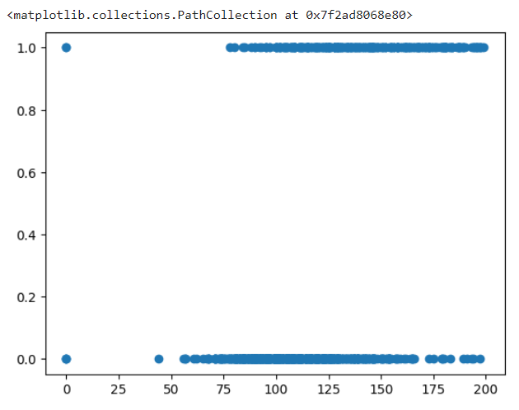
Scatter Plot of Glucose and Outcome:

Slide 14
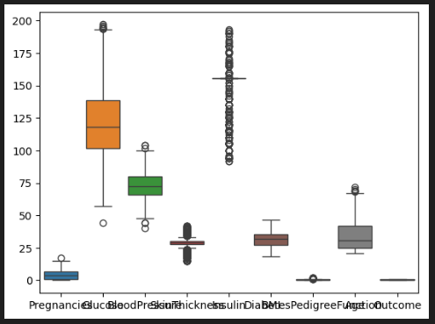
Boxplot:

Slide 15
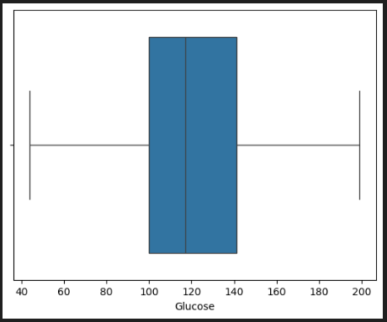
Boxplot of Glucose:

Slide 16
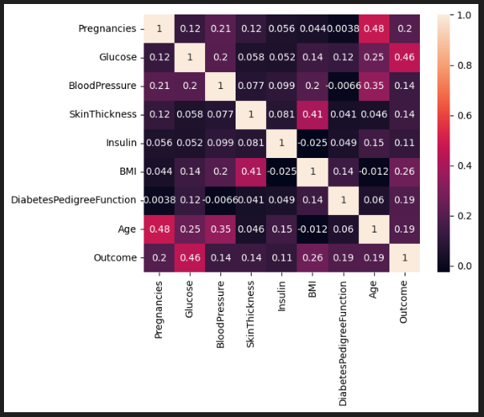
Heat map:

Slide 17
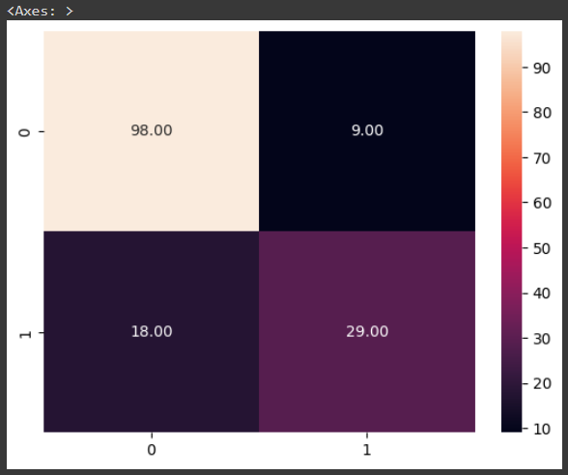
Confusion matrix of Logistic Regression:

Slide 18
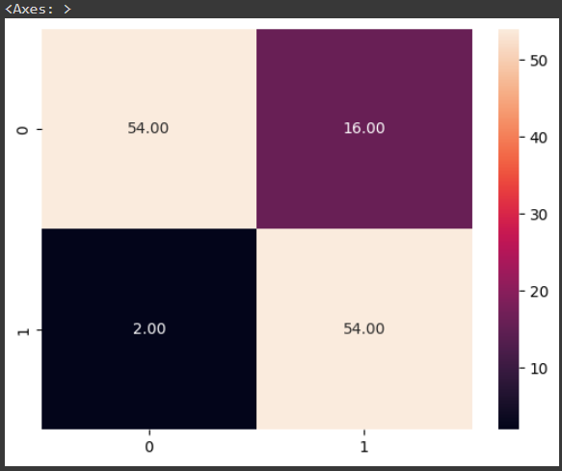
Confusion Matrix of Gradient Boost:

Slide 19
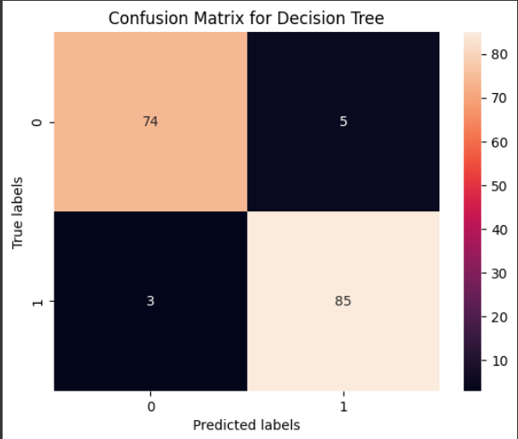
Confusion matrix of Decision tree:

Slide 20
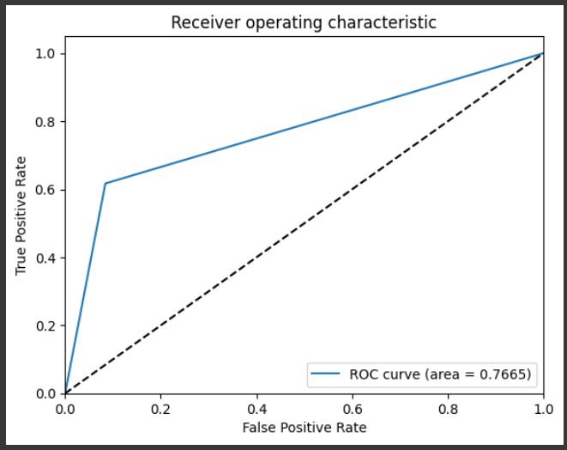
ROC of Logistic Regression:

Slide 21
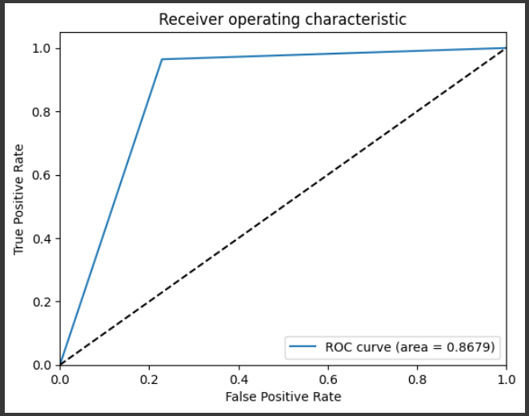
ROC of gradient Boost:

Slide 22
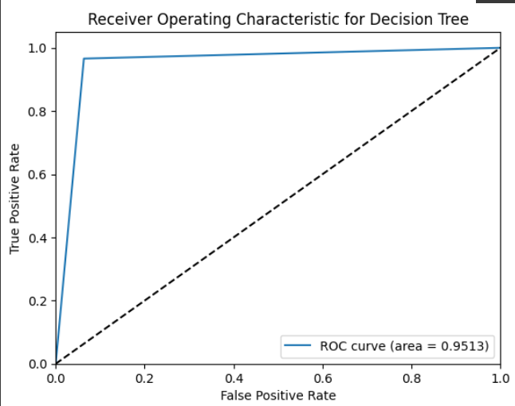
ROC curve of Decision tree:

Slide 23
CONCLUSION
S.No | Algorithm | Accuracy
1 | Logistic Regression | 82
2 | Gradient Boost | 86
3 | Decision Tree | 95
Finally we conclude that Decision Algorithm achieved the highest accuracy among all the classification algorithms for predicting the diabetes using the PIMA Indian diabetes dataset

Slide 24
REFERENCES
A. Alazwari, A. Johnstone, L. Tafakori, M. Abdollahian, A.M. AlEidan, K. Alfuhigi, M.A. Alshamrani, Predicting the development of T1D and identifying its Key Performance Indicators in children; a case-control study in Saudi Arabia, PLoS One 18 (3) (2023), e0282426.
S. Musa, I. Dergaa, V. Bachiller, H.B. Saad, Global implications of COVID-19 pandemic on adults’ lifestyle behavior: the invisible pandemic of noncommunicable disease, Int. J. Prev. Med. 14 (1) (2023) 15.
S.S. Bhat, V. Selvam, G.A. Ansari, M.D. Ansari, M.H. Rahman, Prevalence and early prediction of diabetes using machine learning in North Kashmir: a case study of district Bandipora, Comput. Intell. Neurosci. 2022 (2022) 12.
S.N. Hong, I.L. Mak, W.Y. Chin, E.Y.T. Yu, E.T.Y. Tse, J.Y. Chen, E.Y.F. Wan, Agespecific associations between the number of co-morbidities, all-cause mortality and public direct medical costs in patients with Type 2 diabetes: a retrospective cohort study, Diabetes Obes. Metabol. 25 (2) (2023) 454–467.
E.S. Almutairi, M.F. Abbod, Machine learning methods for diabetes prevalence classification in Saudi arabia, Modelling 4 (1) (2023) 37–55.
J. Rashid, S. Batool, J. Kim, M. Wasif Nisar, A. Hussain, S. Juneja, R. Kushwaha, An augmented artificial intelligence approach for chronic diseases prediction, Front. Public Health 10 (2022) 559.

Slide 25
THANK YOU

